Slide 1
Chapter 18
Exploratory Factor Analysis

Slide 2
When and Why?
To test for clusters of variables or measures.
To see whether different measures are tapping aspects of a common dimension.
  E.g. Anal-Retentiveness, number of friends and social skills might be aspects of the common dimension of ‘statistical ability’.

Slide 3

Notes:
Figure 4.2: Unidimensional test.

Slide 4
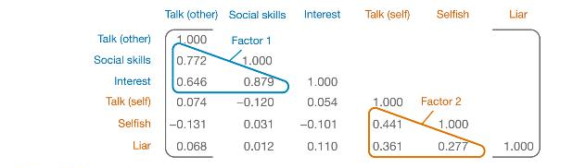
R-Matrix

Slide 5
Factors and Components
Factor analysis attempts to achieve parsimony by explaining the maximum amount of common variance in a correlation matrix using the smallest number of explanatory constructs.
  These ‘explanatory constructs’ are called factors.
PCA tries to explain the maximum amount of total variance in a correlation matrix.
  It does this by transforming the original variables into a set of linear components.

Slide 6
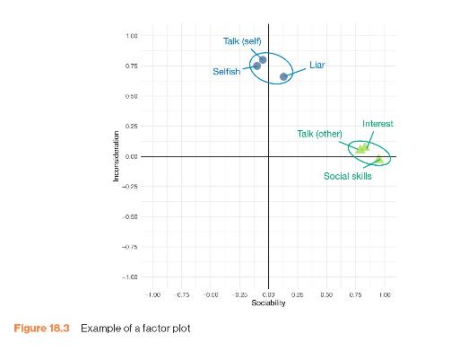
Graphical Representation

Slide 7
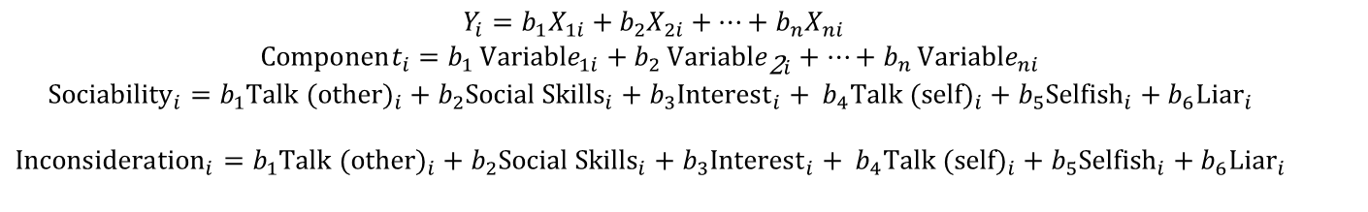
Mathematical Representation: Components
$$\begin{matrix} Y_{i}=b_{1}X_{1i}+b_{2}X_{2i}+…+b_{n}X_{ni} \\ Component_{i}=b_{1} Variable_{1i}+b_{2} Variable_{\text{2}i}+…+b_{n} Variable_{ni} \\ {\text{Sociability}}_{i}=b_{1}{\text{Talk} \text{(}\text{other}\text{)}}_{i}+b_{2}{\text{Social} \text{Skills}}_{i}+b_{3}{\text{Interest}}_{i}+ b_{4}{\text{Talk} \text{(}\text{self}\text{)}}_{i}+b_{5}{\text{Selfish}}_{i}+b_{6}{\text{Liar}}_{i} \\ \\ {\text{Inconsideration}}_{i}=b_{1}{\text{Talk}\text{ (}\text{other}\text{)}}_{i}+b_{2}{\text{Social} \text{Skills}}_{i}+b_{3}{\text{Interest}}_{i}+ b_{4}{\text{Talk}\text{ (}\text{self}\text{)}}_{i}+b_{5}{\text{Selfish}}_{i}+b_{6}{\text{Liar}}_{i} \\ \end{matrix}$$

Slide 8
Mathematical Representation: Factors
The factors in factor analysis are not represented in the same way as components.
$$\begin{matrix} x=µ+Λξ+δ \\ \text{Variables}=\text{Variable} \text{Means}+\left(\text{Loadings} × \text{Common} \text{Factor}\right)+\text{Unique} \text{Factor}\end{matrix}$$

Slide 9
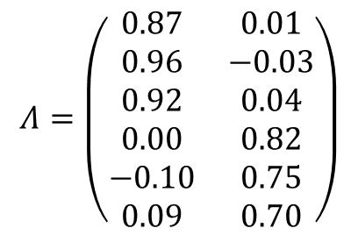
Factor Loadings
Both factor analysis and PCA are linear models in which loadings are used as weights.
  These loadings can be expressed as a matrix.
  This matrix is called the factor matrix or component matrix (if doing PCA).
  The assumption of factor analysis (but not PCA) is that these algebraic factors represent real-world dimensions.
$$Λ=\left(\begin{matrix}0.87 & 0.01 \\ 0.96 & −0.03 \\ 0.92 & 0.04 \\ 0.00 & 0.82 \\ −0.10 & 0.75 \\ 0.09 & 0.70\end{matrix}\right)$$

Slide 10
Initial Considerations
The quality of analysis depends upon the quality of the data (GI⇒GO).
Test variables should correlate quite well
  r > 0.3
Avoid multicollinearity:
  several variables highly correlated, r > 0.80
Avoid singularity:
  some variables perfectly correlated, r = 1.
Screen the correlation matrix, eliminate any variables that obviously cause concern

Slide 11
Finding Factors: Communality
Common variance:
  Variance that a variable shares with other variables.
Unique variance:
  Variance that is unique to a particular variable.
The proportion of common variance in a variable is called the communality
  Communality = 1, All variance shared.
  Communality = 0, No variance shared.
  0 < Communality < 1 = Some variance shared.

Slide 12
Communality = 1
Variance of
Variable 3
Variance of
Variable 1
Variance of
Variable 2
Communality = 0
Variance of
Variable 4

Slide 13
Finding Factors
We find factors by calculating the amount of common variance
Principal components analysis:
  Assume all variance is shared
  All communalities = 1
Factor Analysis
  Estimate communality
  Use squared multiple correlation (SMC)

Slide 14
Factor Extraction
Kaiser’s extraction
  Kaiser (1960): retain factors with eigen values > 1
Scree plot
  Cattell (1966): use ‘point of inflexion’ of the scree plot
Which rule?
  Use Kaiser’s extraction when
    Less than 30 variables, communalities after extraction > 0.7
    Sample size > 250 and mean communality ≥ 0.6
  Scree plot is good if sample size is > 200

Slide 15
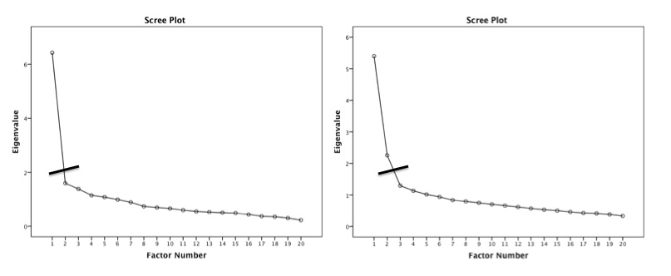
Scree Plot Examples

Slide 16
Rotation
To aid interpretation it is possible to maximize the loading of a variable on one factor while minimizing its loading on all other factors.
This is known as factor rotation.
There are two types:
  Orthogonal (factors are uncorrelated)
  Oblique (factors correlate).

Slide 17
Orthogonal
Oblique

Slide 18
Reliability
Test-retest method
  What about practice effects/mood states?
Alternate form method
  Expensive and impractical
Split-half method
  Splits the questionnaire into two random halves, calculates scores and correlates them.
Cronbach’s alpha
  Splits the questionnaire into all possible halves, calculates the scores, correlates them and averages the correlation for all splits (well, sort of …).
  Ranges from 0 (no reliability) to 1 (complete reliability).

Slide 19
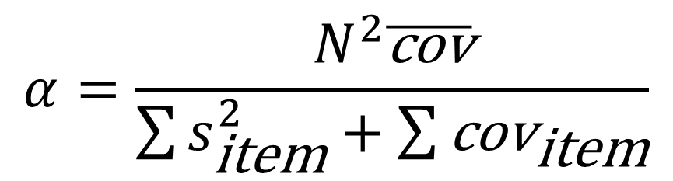
Cronbach’s Alpha
$$α=\frac{N^{2}\overline{\text{cov}}}{\sum{s_{\text{item}}^{2}}+\sum{{\text{cov}}_{\text{item}}}}$$

Slide 20
Interpreting Cronbach’s Alpha
Kline (1999)
  Reliable if α > 0.7
Depends on the number of items
  More questions = bigger α
Treat subscales separately
Remember to reverse score reverse phrased items!
  If not, α is reduced and can even be negative

Slide 21
The End?
Describe factor structure/reliability.
What items should be retained?
  What items did you eliminate and why?
Application
  Where will your questionnaire be used?
  How does it fit in with psychological theory?

